Slide 1
Soldiers Surf Free
Progress meeting

Slide 2
What we've done so far
ERD design.
The search and research about hardware.
Hardware order.
Finding the right libraries for the hardware.
Finding the right physical connections to the sensors.
Github repository created.
Basic infrastructure created.
This presentation. :)

Slide 3
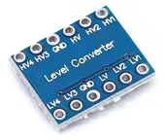
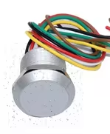
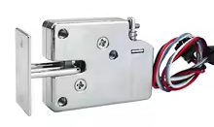
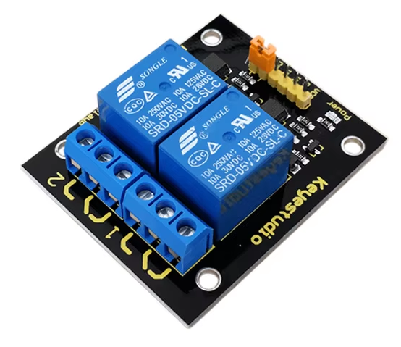
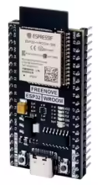
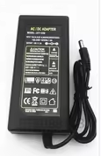
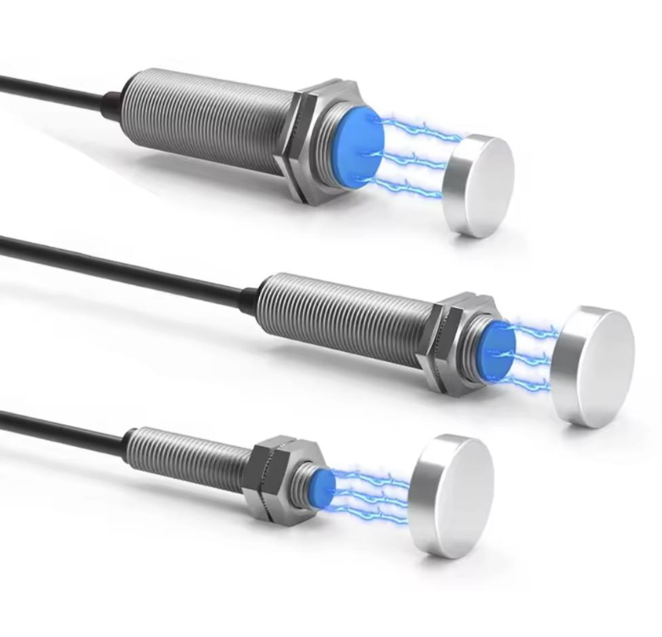
Hardware specification

Slide 4
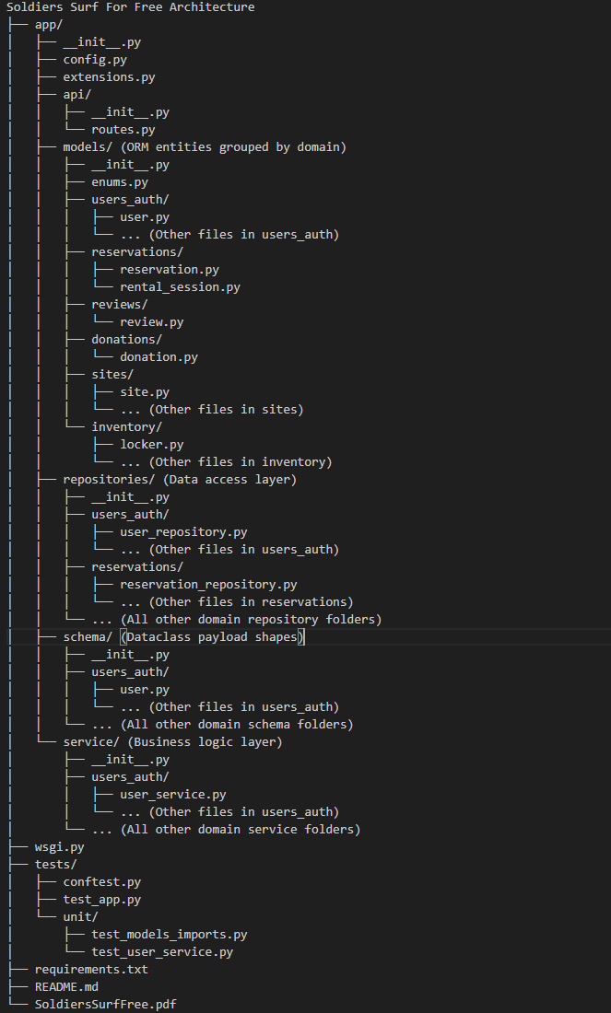
Architecture
architecture for python using-
Flask API SQLAlchemy

Slide 5
Alpha
The initial Alpha Version focuses on delivering the end-to-end functionality required to validate the system's most complex and critical transaction: Borrowing a Surfboard.
The alpha will include
Authentication
health and liability waiver.
User Management
User Login/Logout and new user creation.
Hardcoded First Admin user for system initialization.
Admin Grant/Revoke Permission Infrastructure (initial framework only).
Core Logic
Rental Session Initiation
Mock Hardware Setup - hardware already ordered, if arrives in time will not be mock.
Log infrastructure

Slide 6
Alpha
The following features are considered by us to be "Nice to Have" and are necessary for full operational readiness, but are deferred from the initial Alpha scope
Item Creation & Configuration
Creating a new Item (Surfboard) Object in the system.
Creating a specific Surfboard Model.
Adding/Removing Items, Lockers, and Sites to the system.
Asset Assignment & Tracking
Assigning/Unassigning Items to Lockers (and vice versa).
Assigning/Modifying a unique RFID Key for each Surfboard.
Site Configuration
Updating operational details for an Item, Locker, or Locker Site.
Modifying Locker Site Policies (e.g., operating hours).

Slide 7
Challenges
Implementing end to end use-case while developing infrastructure for the whole system.
Simulate some external services (auth, cognito).
Establish the connection between the server and the microcontroller.
Create a simulate hardware circuit.
Making the main use case efficient for the user to use.

Slide 8
How to solve them
Implement the bases of the system while focusing on developing the main branch to gain an end to end use-case
Mock external services behaviour.
Research about working with ESP32 and establish server - controller communication.
Trial and error, order hardware redundancy
Saving user credentials, health and liability waivers to guarantee the next time of trying to initiate a rental session will be faster.

Slide 9
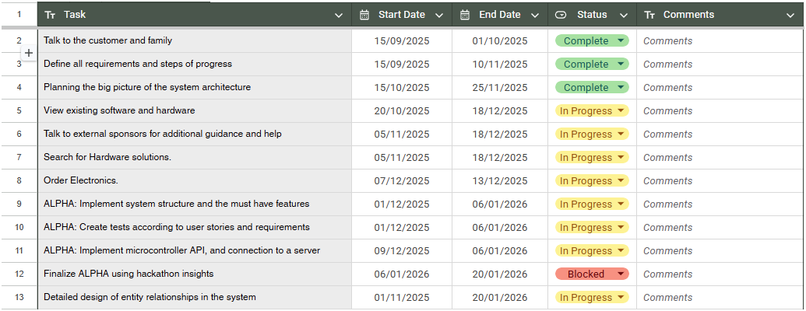
Gantt graph - Alpha

Slide 10
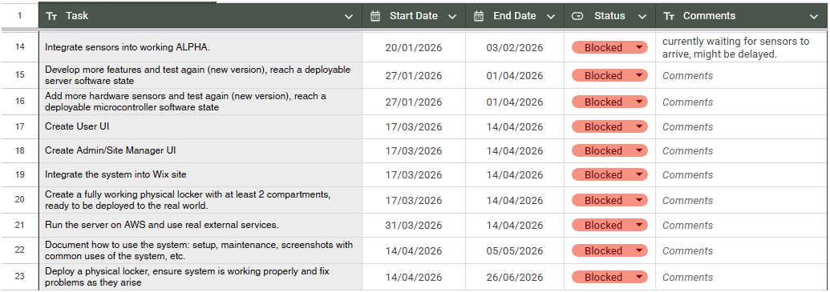
Gantt graph - Beta

